Slide 1
L463-010501- Injection Moulded ACCESS PANEL PBOM
15/07/2026

Slide 2
L463-010501- TPO ACCESS PANELS PBOM
General Notes
Take rates and volumes included in ESOW cost pack
Part geometry is subject to change as CAD maturation progresses
Dimensions are bounding box ONLY, Always refer to CAD as master

Slide 3
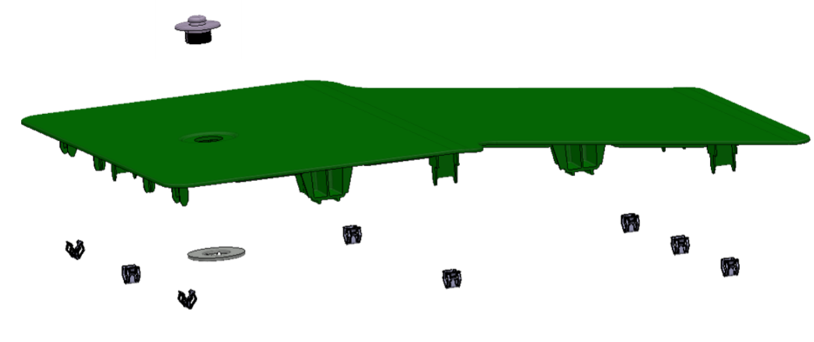
Exploded View: 6 SEAT ACCESS PANEL
CAD REFERENCE: EI_ Z7B2-13A994-AAW
Sr.no. | Part Name | Qty. | Remark
1 | 6 SEAT ACCESS PANEL | 1 | IM Process
2 | ITW MAT CLIP | 1 | Clip Assy Process
3 | W780230-S CLIP STANDARD | 8 | Clip Assy Process
1
2
3
Proposed Material - ABS MAGNUM 3325
Colour – Shadow
Grain – TBC

Slide 4
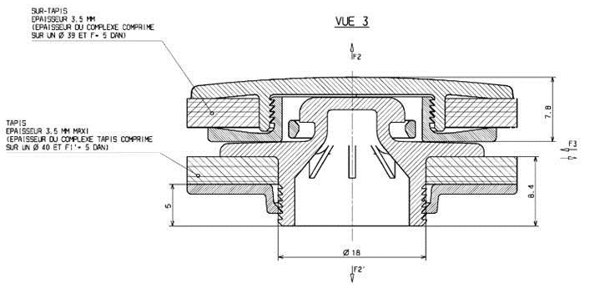
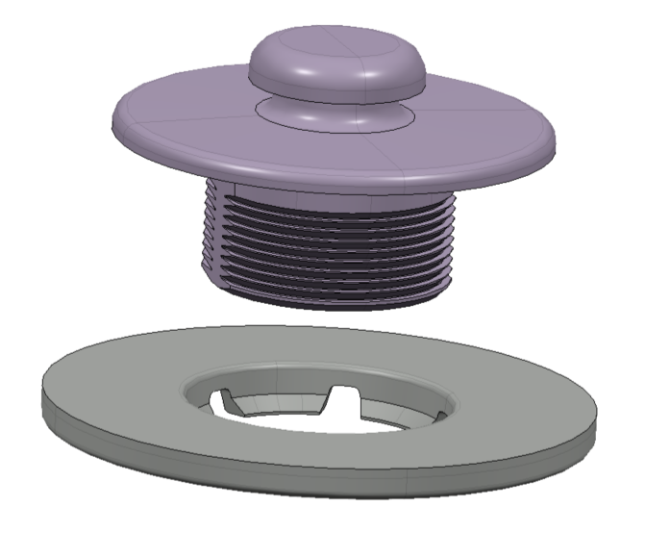
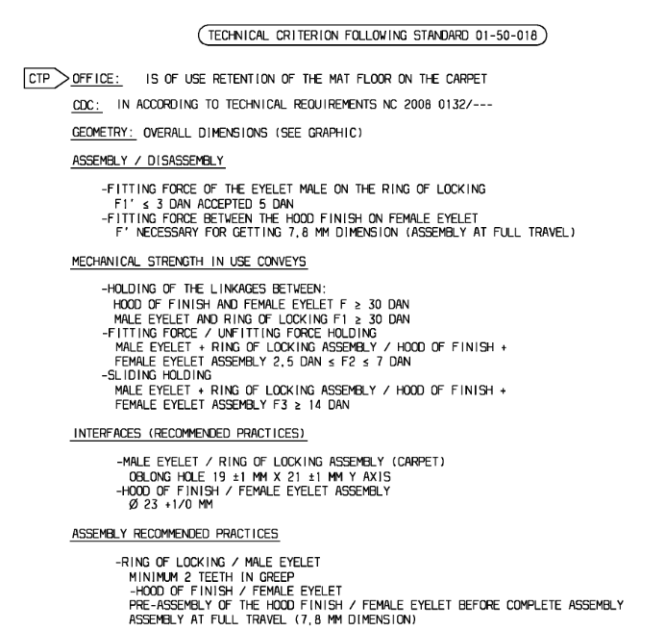
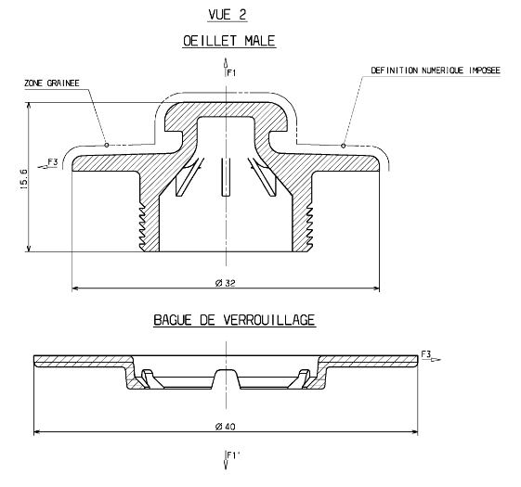
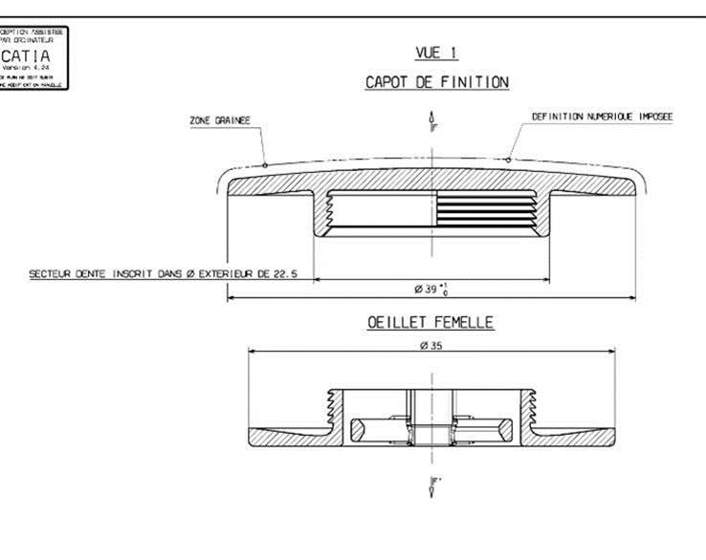
Exploded View: 6 SEAT ACCESS PANEL – ITW CLIP

Slide 5
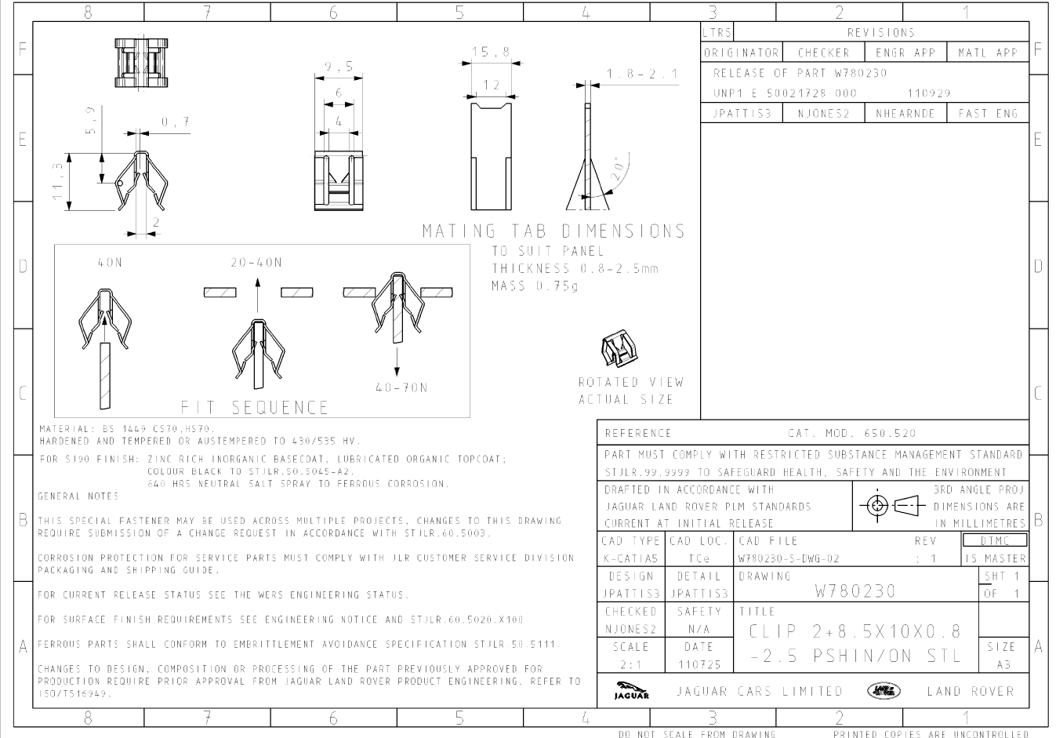
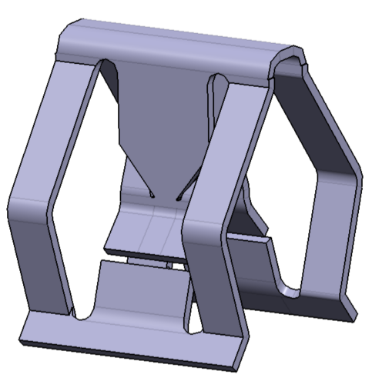
Exploded View: 6 SEAT ACCESS PANEL – ITW CLIP

Slide 6
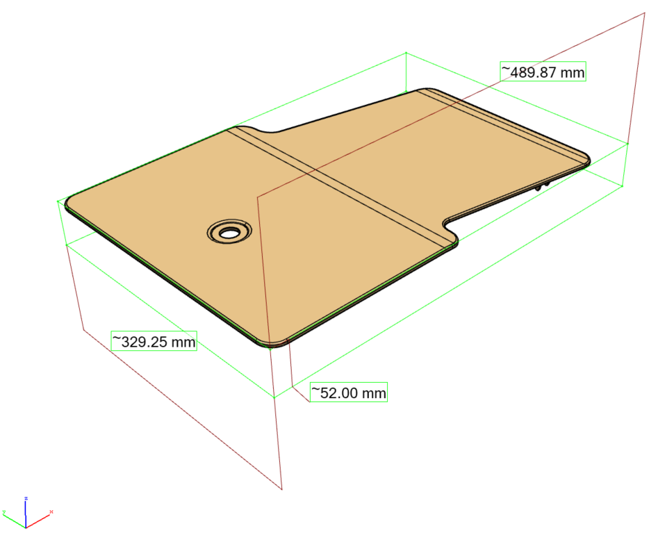
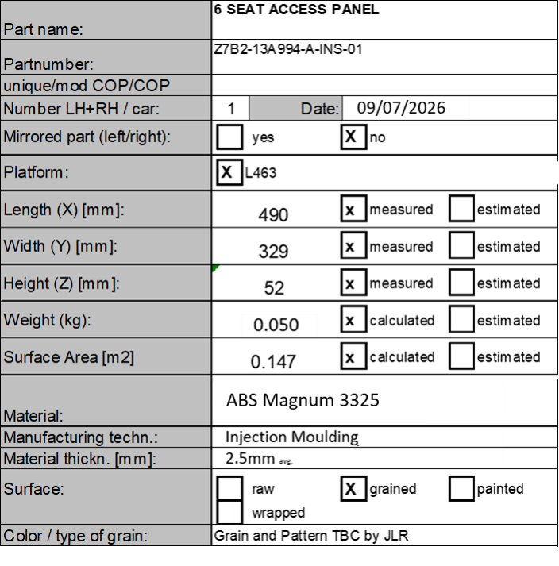
Exploded View: 6 SEAT ACCESS PANEL – INJECTION MOULDING
CAD REFERENCE: EI_ Z7B2-13A994-AAW
CAVITY ASSUMPTION: 1 CAV TOOL
*Dimensions are bounding box

Slide 7
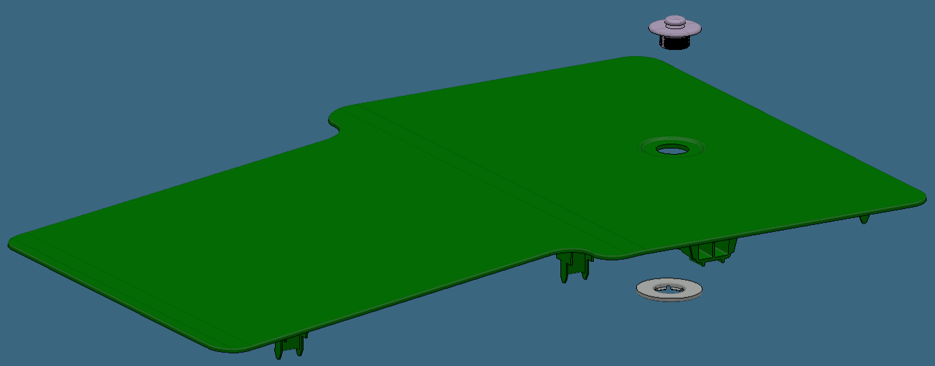
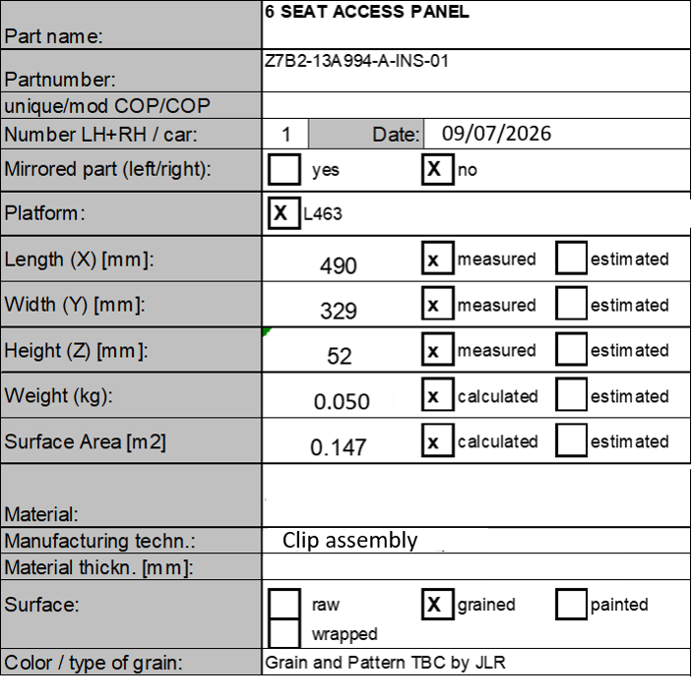
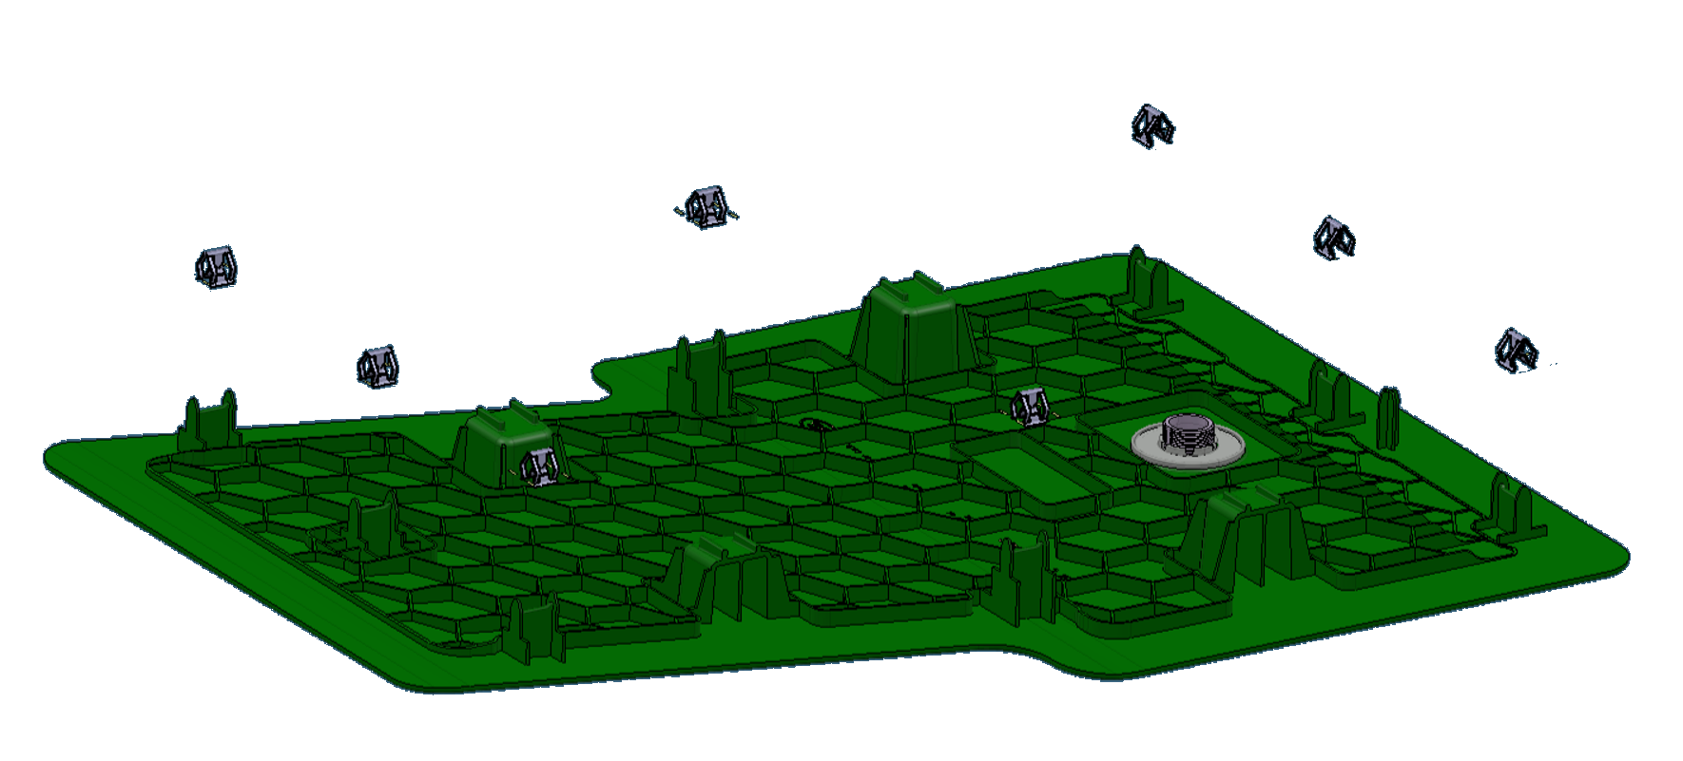
Exploded View: 6 SEAT ACCESS PANEL
CAD REFERENCE: EI_ Z7B2-13A994-AAW
CAVITY ASSUMPTION: 1 CAV TOOL
1x MAT CLIP ASSY
8x METAL CLIP ASSY
*Dimensions are bounding box

